Slide 1
Accusative vs. Dative: 2 way Prepositions
Claire Chen and Carolyn Huey

Slide 2
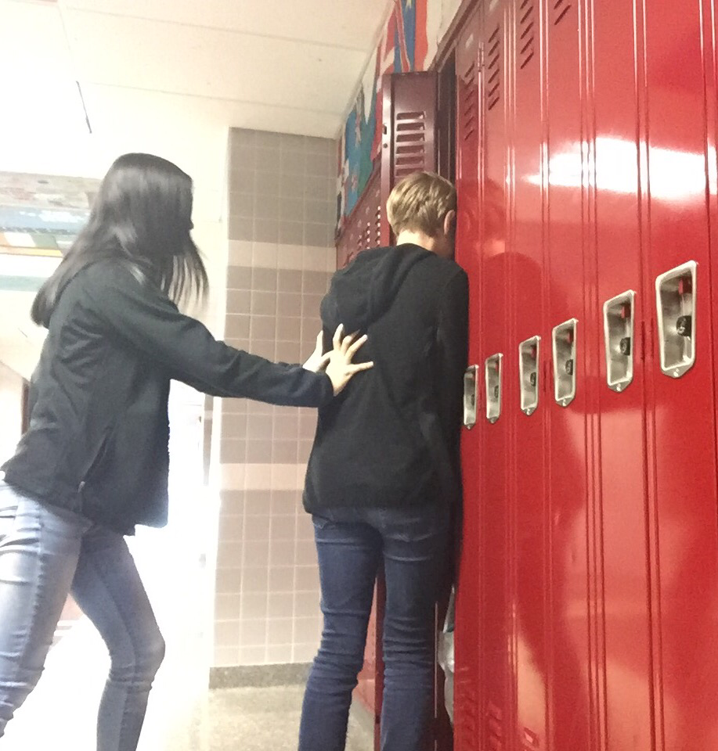
Claire drückt Huey in ______ Schließfach.
Verb: drückt (push)
Gender of object: neuder
Accusative or Dative: Accusative
Why: Huey is being pushed in to the locker. There is movement into something.
Claire drückt Huey in das Schließfach.

Slide 3
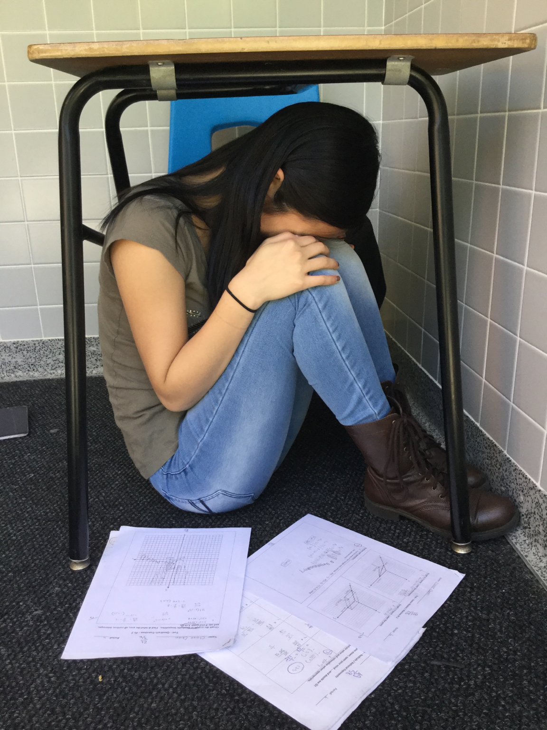
Claire weint unter _____ Schreibtisch.
Verb: weint (cry)
Gender of object: masculine
Accusative or Dative: Dative
Why: Claire is not going into something, but is in a stationary location.
Claire weint unter dem Schreibtisch.

Slide 4
The end

